Slide 1
Lecture 18: Perceptron

Slide 2
ANNOUNCEMENTS
Homework 5 (209) due on Wednesday 11:59 pm, Nov 6
Advanced Section:
HW7
is near

Slide 3
Outline
Introduction to Artificial Neural Networks
Review of Classification and Logistic Regression
Single Neuron Network (‘Perceptron’)

Slide 4
Artificial Neural Networks

Slide 5
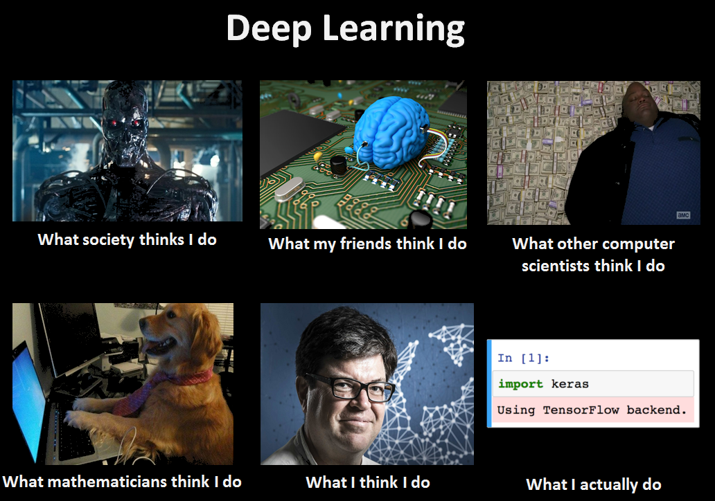

Slide 6
Watch this!
http://video.arstechnica.com/watch/sunspring-sci-fi-short-film

Slide 7

Today’s news

Slide 8
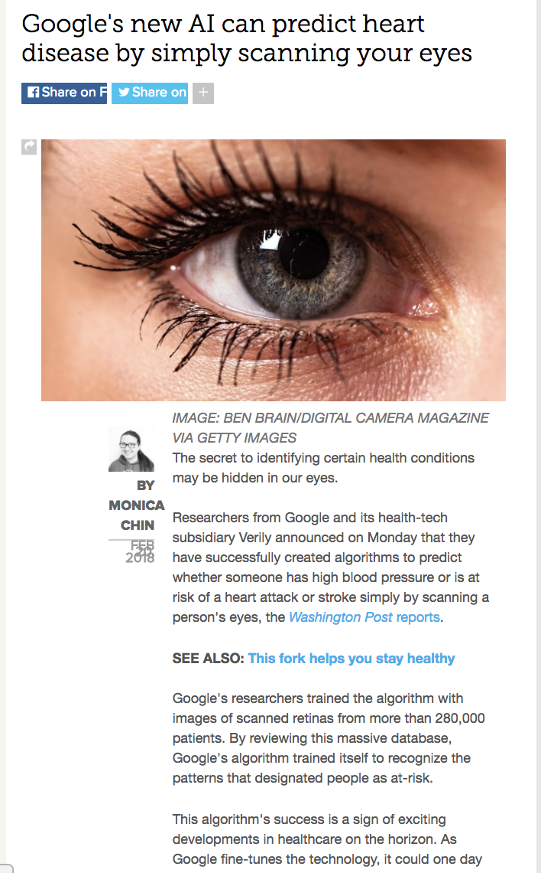
Today’s news

Slide 9
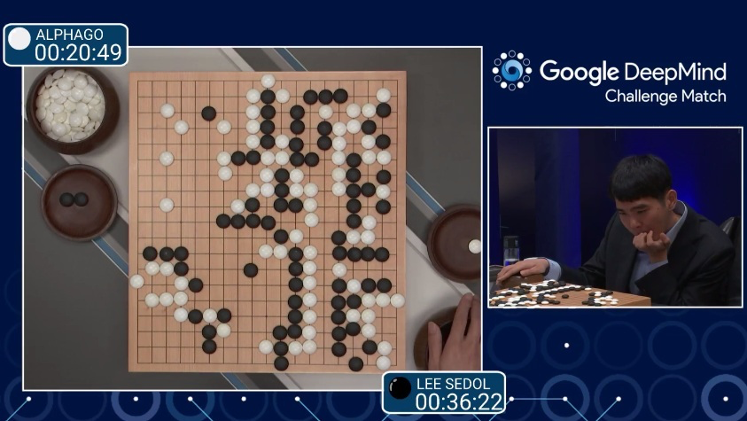
AlphaGo (2015)
First program to beat a professional Go player
Notes:
https://www.youtube.com/watch?v=PQCrX1sQSzY

Slide 10
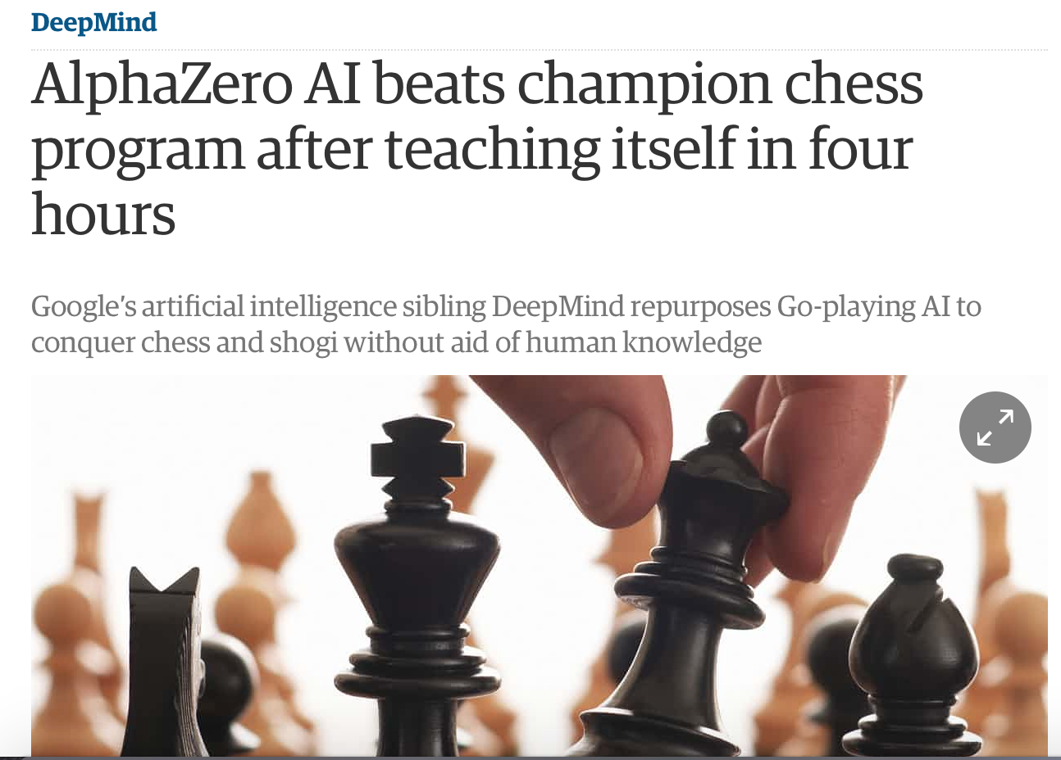
AlphaZero (2017)

Slide 11
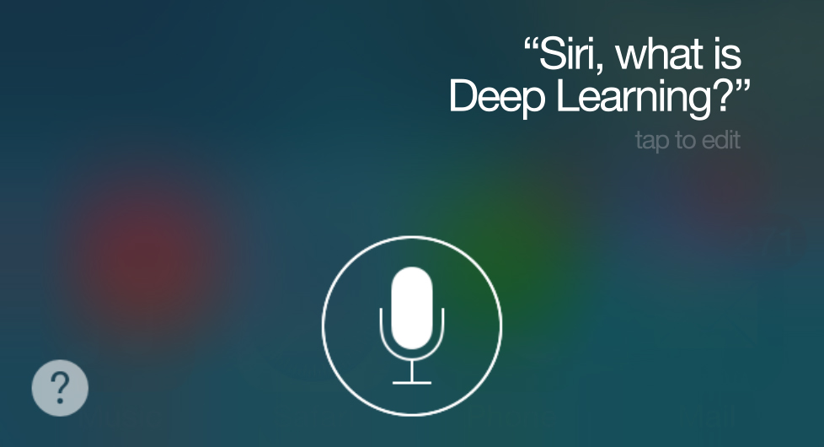
iOS Speech Synthesis (2016-)
Trained from 20 hours of high quality speech
machinelearning.apple.com
Notes:
https://machinelearning.apple.com/2017/08/06/siri-voices.html

Slide 12
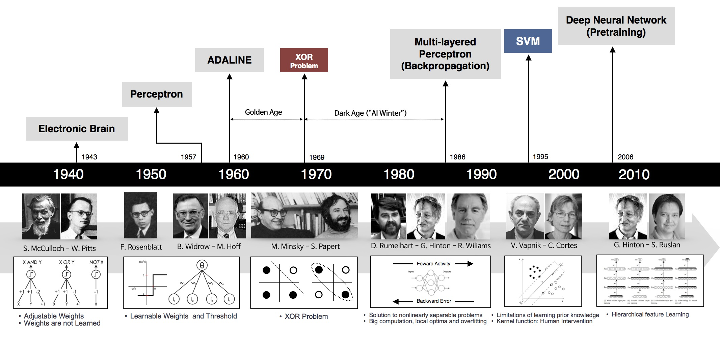
Historical Trends
beamandrew.github.io/

Slide 13
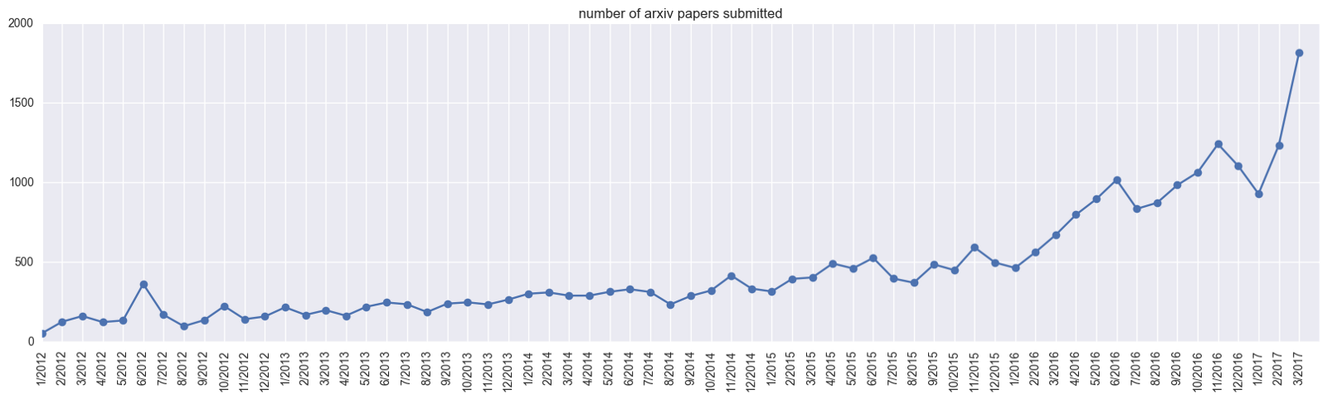
Historical Trends
ArXiv papers on deep learning: 2012-2017
ArXiv papers on deep learning: 2012-2017

Slide 14
Outline
Introduction to Artificial Neural Networks
Review of Classification and Logistic Regression
Single Neuron Network (‘Perceptron’)

Slide 15
Classification and Logistic Regression

Slide 16
Regression and Classification
Methods that are centered around modeling and prediction of a quantitative response variable (ex, number of taxi pickups, number of bike rentals, etc) are called regressions (and Ridge, LASSO, etc).
When the response variable is categorical, then the problem is no longer called a regression problem but is instead labeled as a classification problem.
The goal is to attempt to classify each observation into a category (aka, class or cluster) defined by Y, based on a set of predictor variables X.

Slide 17
Typical Classification Examples
The motivating examples for this lecture(s), homeworks and labs are based on classification. Classification problems are common in these domains:
Trying to determine where to set the cut-off for some diagnostic test (pregnancy tests, prostate or breast cancer screening tests, etc...)
Trying to determine if cancer has gone into remission based on treatment and various other indicators
Trying to classify patients into types or classes of disease based on various genomic markers

Slide 18
Data: Response vs. Predictor Variables
X
predictors
features
covariates
Y
outcome
response variable
dependent variable
TV | radio | newspaper | sales
230.1 | 37.8 | 69.2 | 22.1
44.5 | 39.3 | 45.1 | 10.4
17.2 | 45.9 | 69.3 | 9.3
151.5 | 41.3 | 58.5 | 18.5
180.8 | 10.8 | 58.4 | 12.9
n observations
p predictors

Slide 19
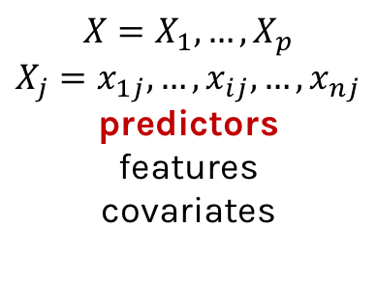
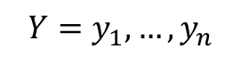
Response vs. Predictor Variables
$$X=X_{1},…,X_{p}$$
$$X_{j}=x_{1j},…,x_{ij},…,x_{nj}$$
predictors
features
covariates
outcome
response variable
dependent variable
$$Y=y_{1},…,y_{n}$$
TV | radio | newspaper | sales
230.1 | 37.8 | 69.2 | 22.1
44.5 | 39.3 | 45.1 | 10.4
17.2 | 45.9 | 69.3 | 9.3
151.5 | 41.3 | 58.5 | 18.5
180.8 | 10.8 | 58.4 | 12.9
n observations
p predictors

Slide 20
Heart Data
response variable Y
is Yes/No
Age | Sex | ChestPain | RestBP | Chol | Fbs | RestECG | MaxHR | ExAng | Oldpeak | Slope | Ca | Thal | AHD
63 | 1 | typical | 145 | 233 | 1 | 2 | 150 | 0 | 2.3 | 3 | 0.0 | fixed | No
67 | 1 | asymptomatic | 160 | 286 | 0 | 2 | 108 | 1 | 1.5 | 2 | 3.0 | normal | Yes
67 | 1 | asymptomatic | 120 | 229 | 0 | 2 | 129 | 1 | 2.6 | 2 | 2.0 | reversable | Yes
37 | 1 | nonanginal | 130 | 250 | 0 | 0 | 187 | 0 | 3.5 | 3 | 0.0 | normal | No
41 | 0 | nontypical | 130 | 204 | 0 | 2 | 172 | 0 | 1.4 | 1 | 0.0 | normal | No

Slide 21
Heart Data
These data contain a binary outcome HD for 303 patients who presented with chest pain. An outcome value of:
Yes indicates the presence of heart disease based on an angiographic test,
No means no heart disease.
There are 13 predictors including:
Age
Sex
Chol (a cholesterol measurement),
MaxHR
RestBP
and other heart and lung function measurements.

Slide 22
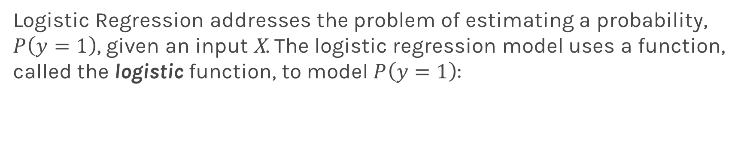
Logistic Regression
Logistic Regression addresses the problem of estimating a probability, $P\left(y=1\right)$, given an input X. The logistic regression model uses a function, called the logistic function, to model $P\left(y=1\right)$:

Slide 23
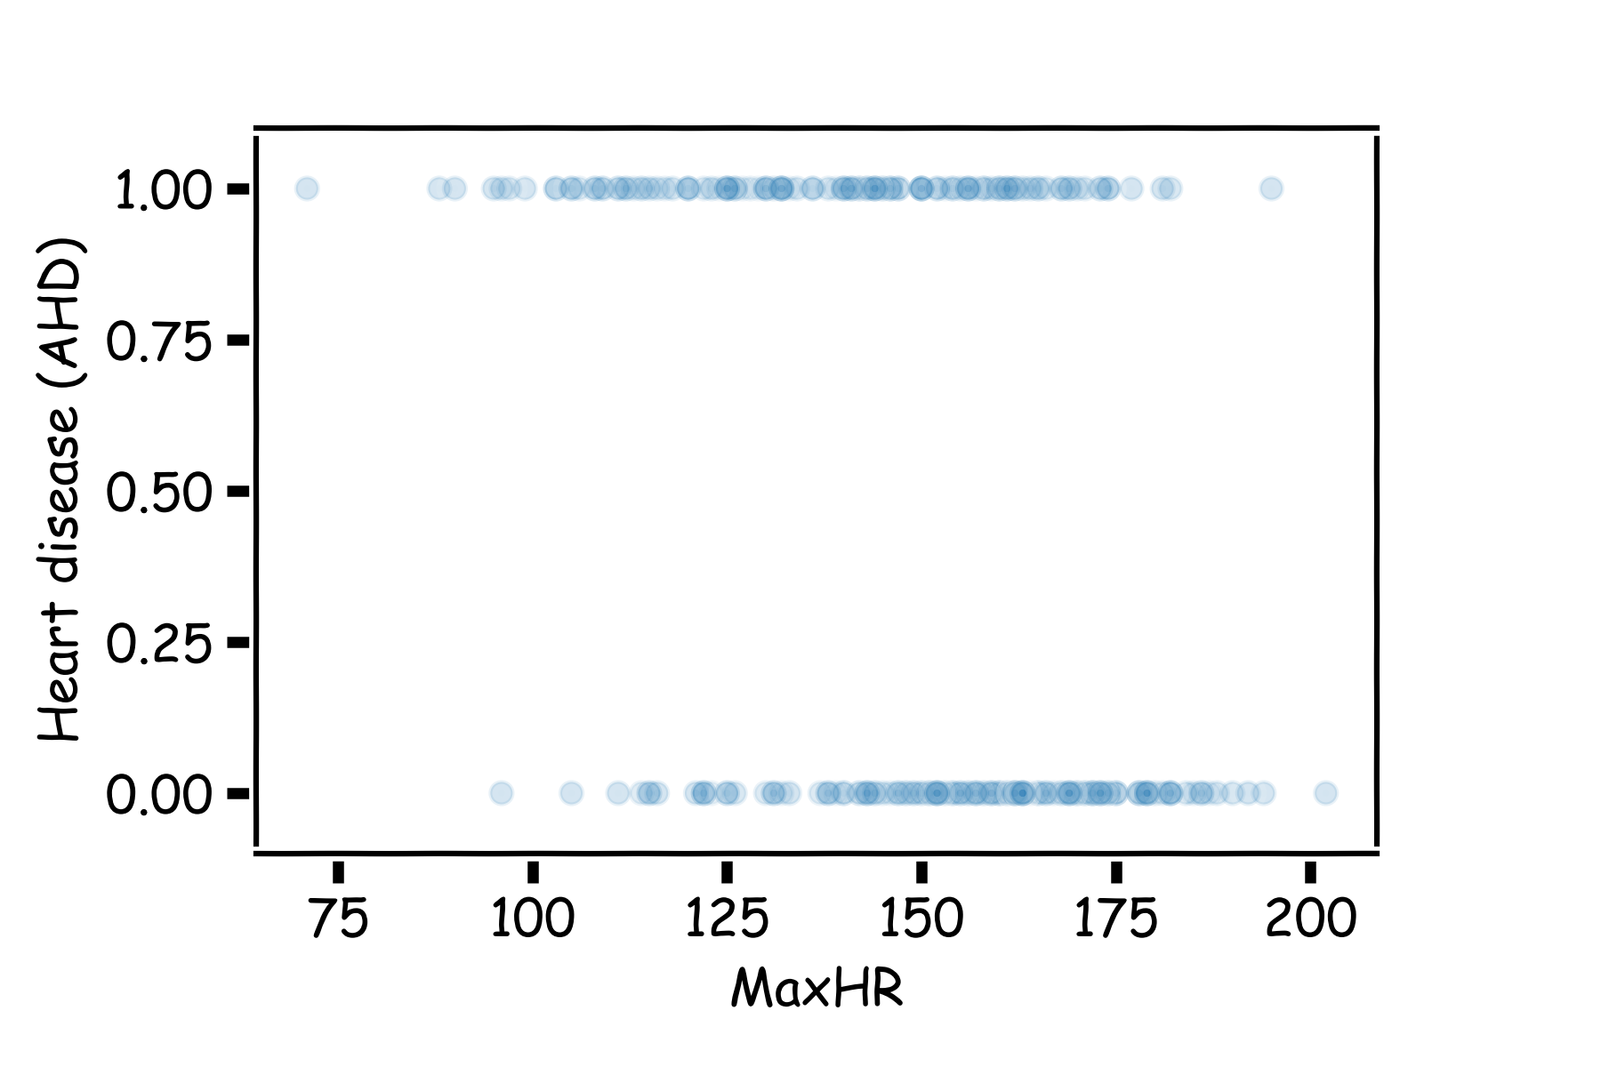
Heart Data: logistic estimation
We'd like to predict whether or not a person has a heart disease. And we'd like to make this prediction, for now, just based on the MaxHR.

Slide 24
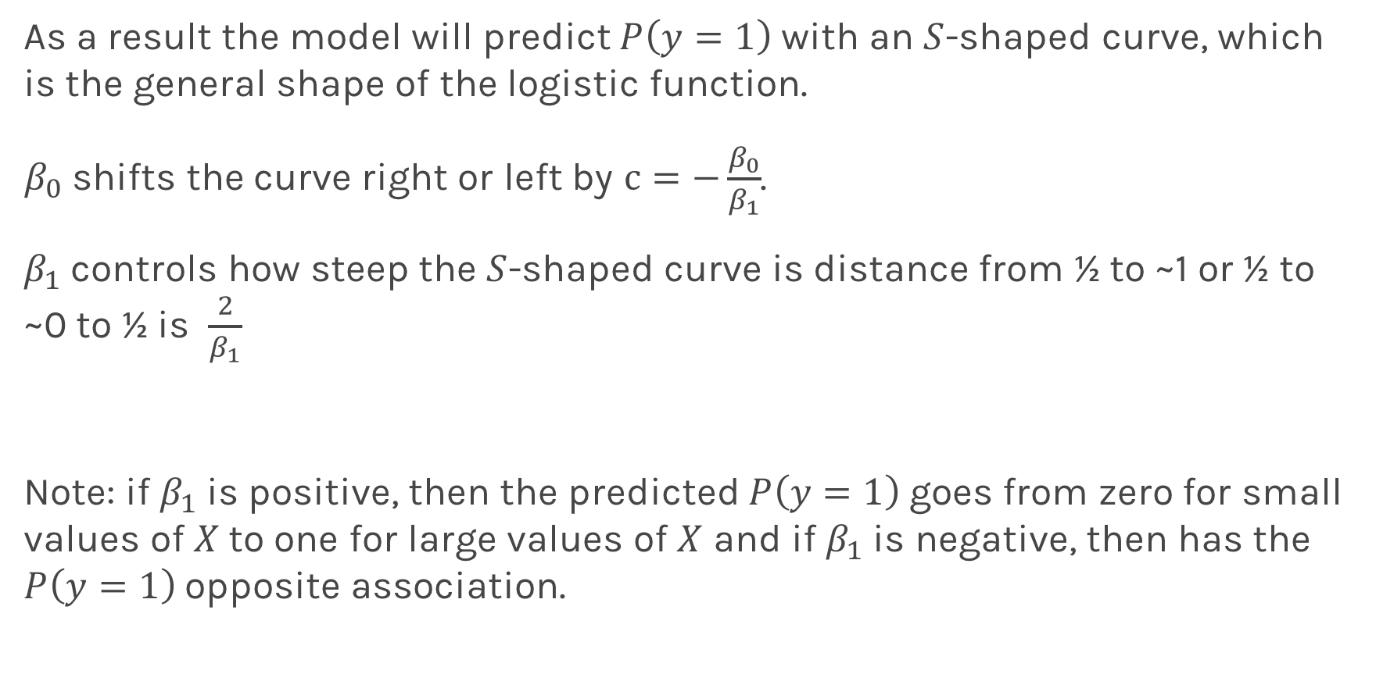
Logistic Regression
As a result the model will predict $P\left(y=1\right)$ with an $S$-shaped curve, which is the general shape of the logistic function.
$β_{0}$ shifts the curve right or left by $c=−\frac{β_{0}}{β_{1}}$.
$β_{1}$controls how steep the $S$-shaped curve is distance from ½ to ~1 or ½ to ~0 to ½ is $\frac{2}{β_{1}}$
Note: if $β_{1}$is positive, then the predicted $P\left(y=1\right)$goes from zero for small values of $X$to one for large values of $X$ and if $β_{1}$is negative, then has the $P\left(y=1\right)$opposite association.

Slide 25
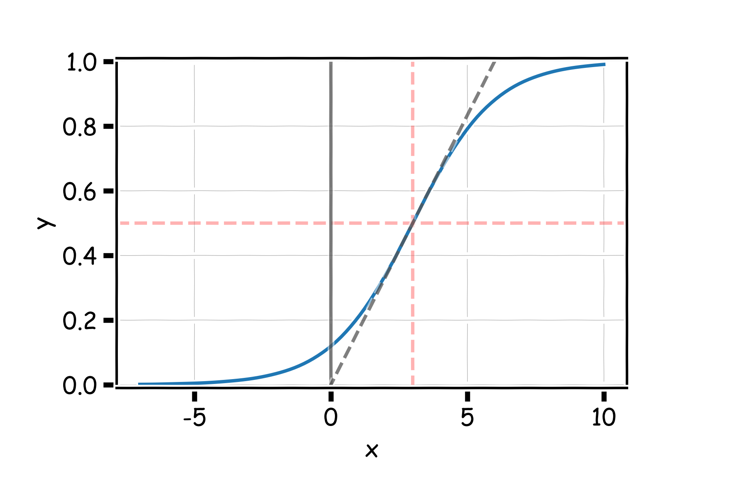
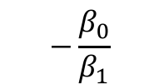

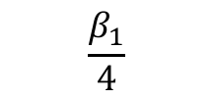
Logistic Regression
$$2β_{1}$$
$$−\frac{β_{0}}{β_{1}}$$
$$\frac{β_{1}}{4}$$

Slide 26
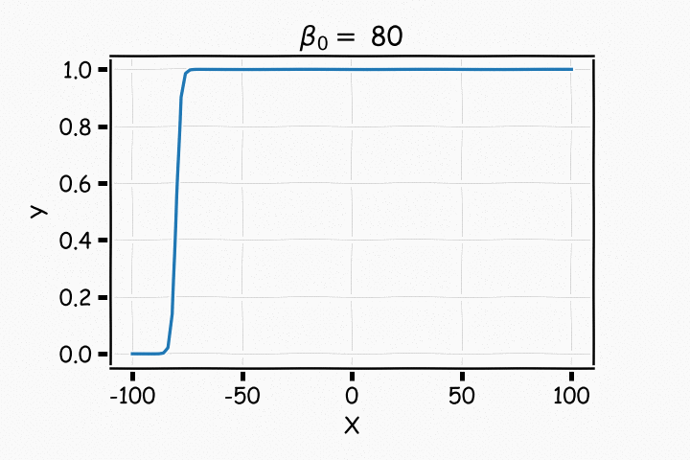
Logistic Regression

Slide 27
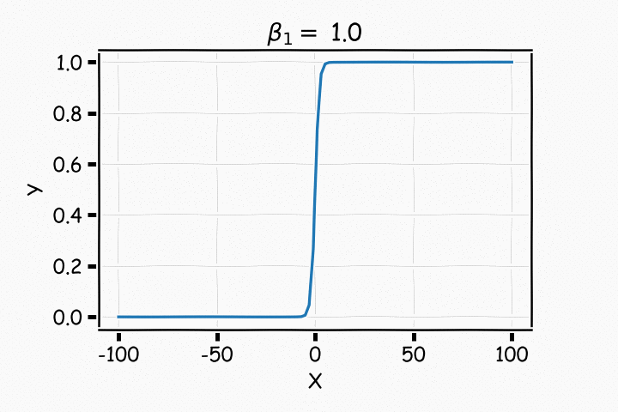
Logistic Regression

Slide 28
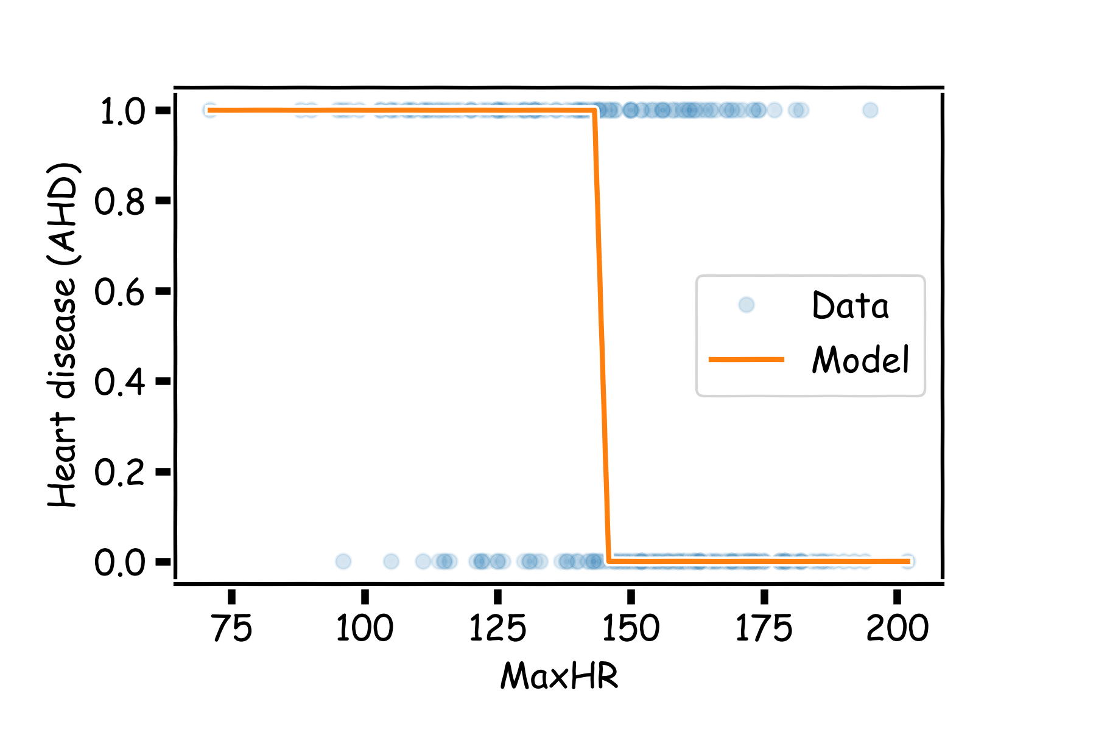
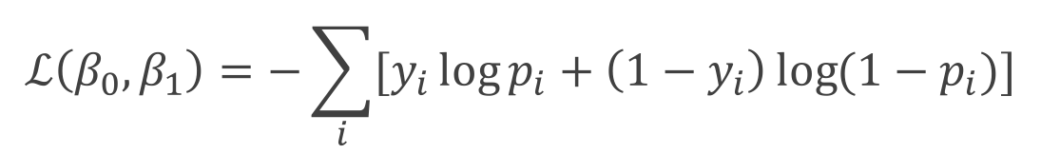
Estimating the coefficients for Logistic Regression
Find the coefficients that minimize the loss function
$$ℒ\left(β_{0}, β_{1}\right)=−\sum_{i}{[y_{i}\log{p_{i}+\left(1−y_{i}\right)\log{(1−p_{i})]}}}$$

Slide 29
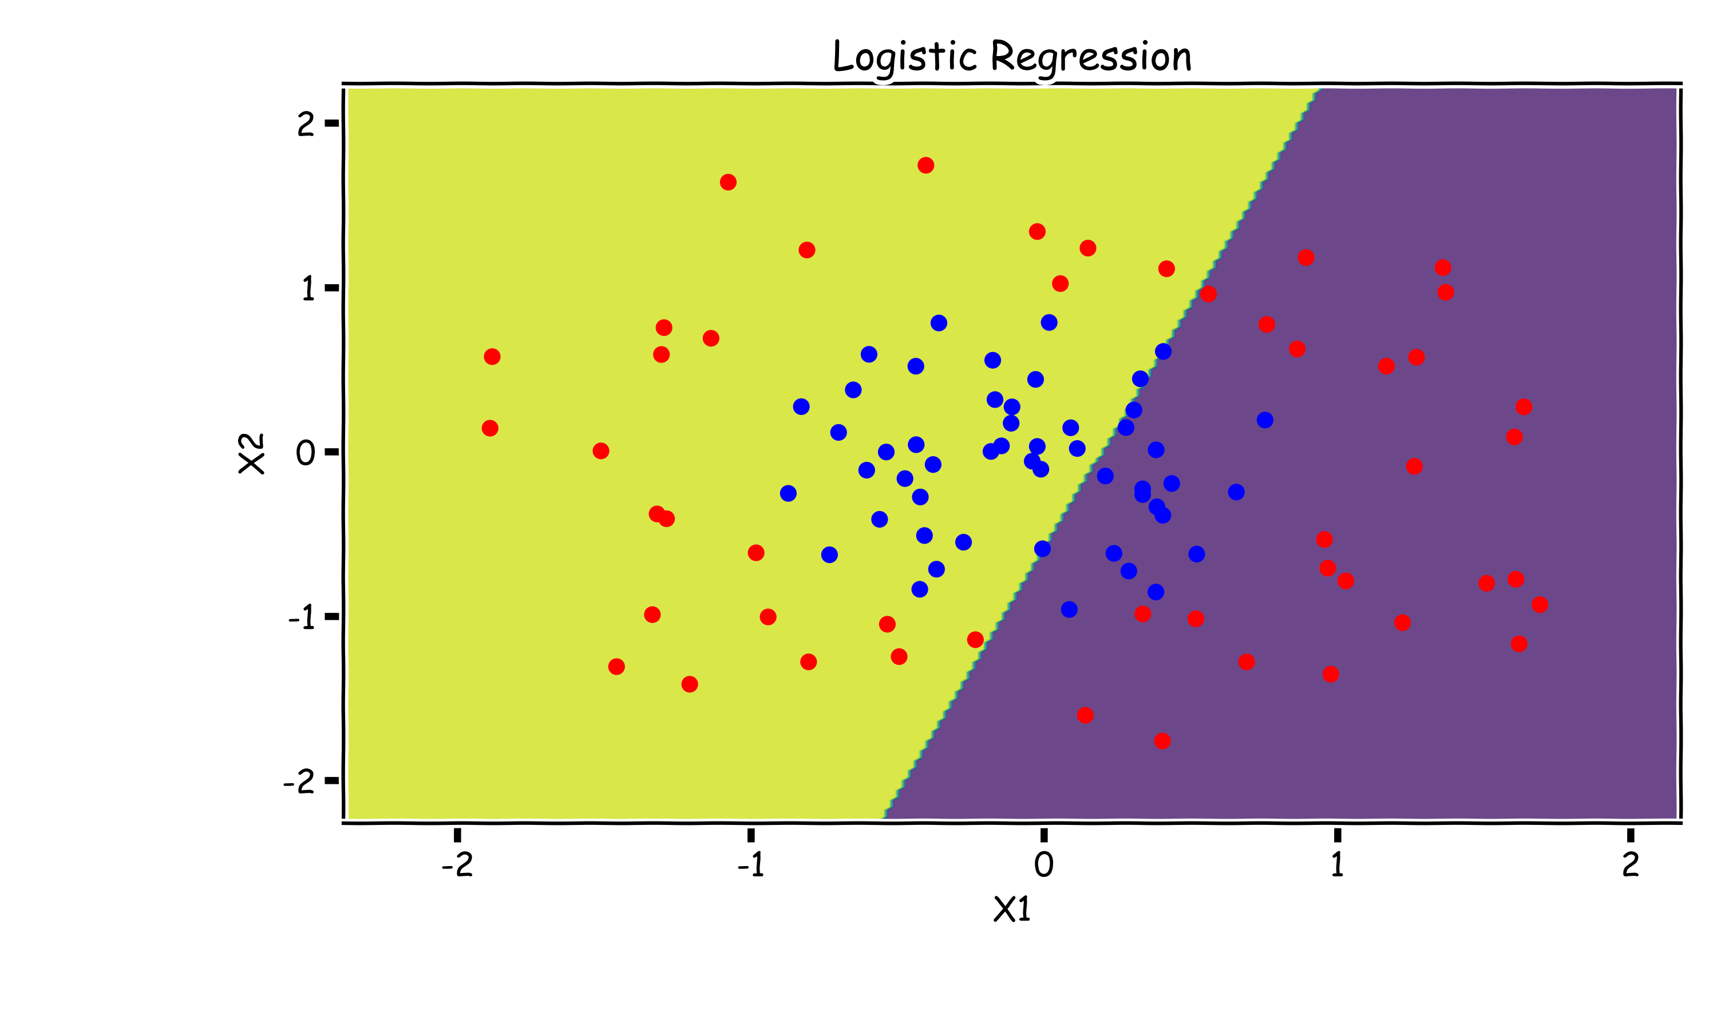
Need for Non-Linearity
Without augmenting the features (i.e. without adding X1² or X2² non-linear features), Logistic Regression is incapable of modeling the correct decision boundary.

Slide 30
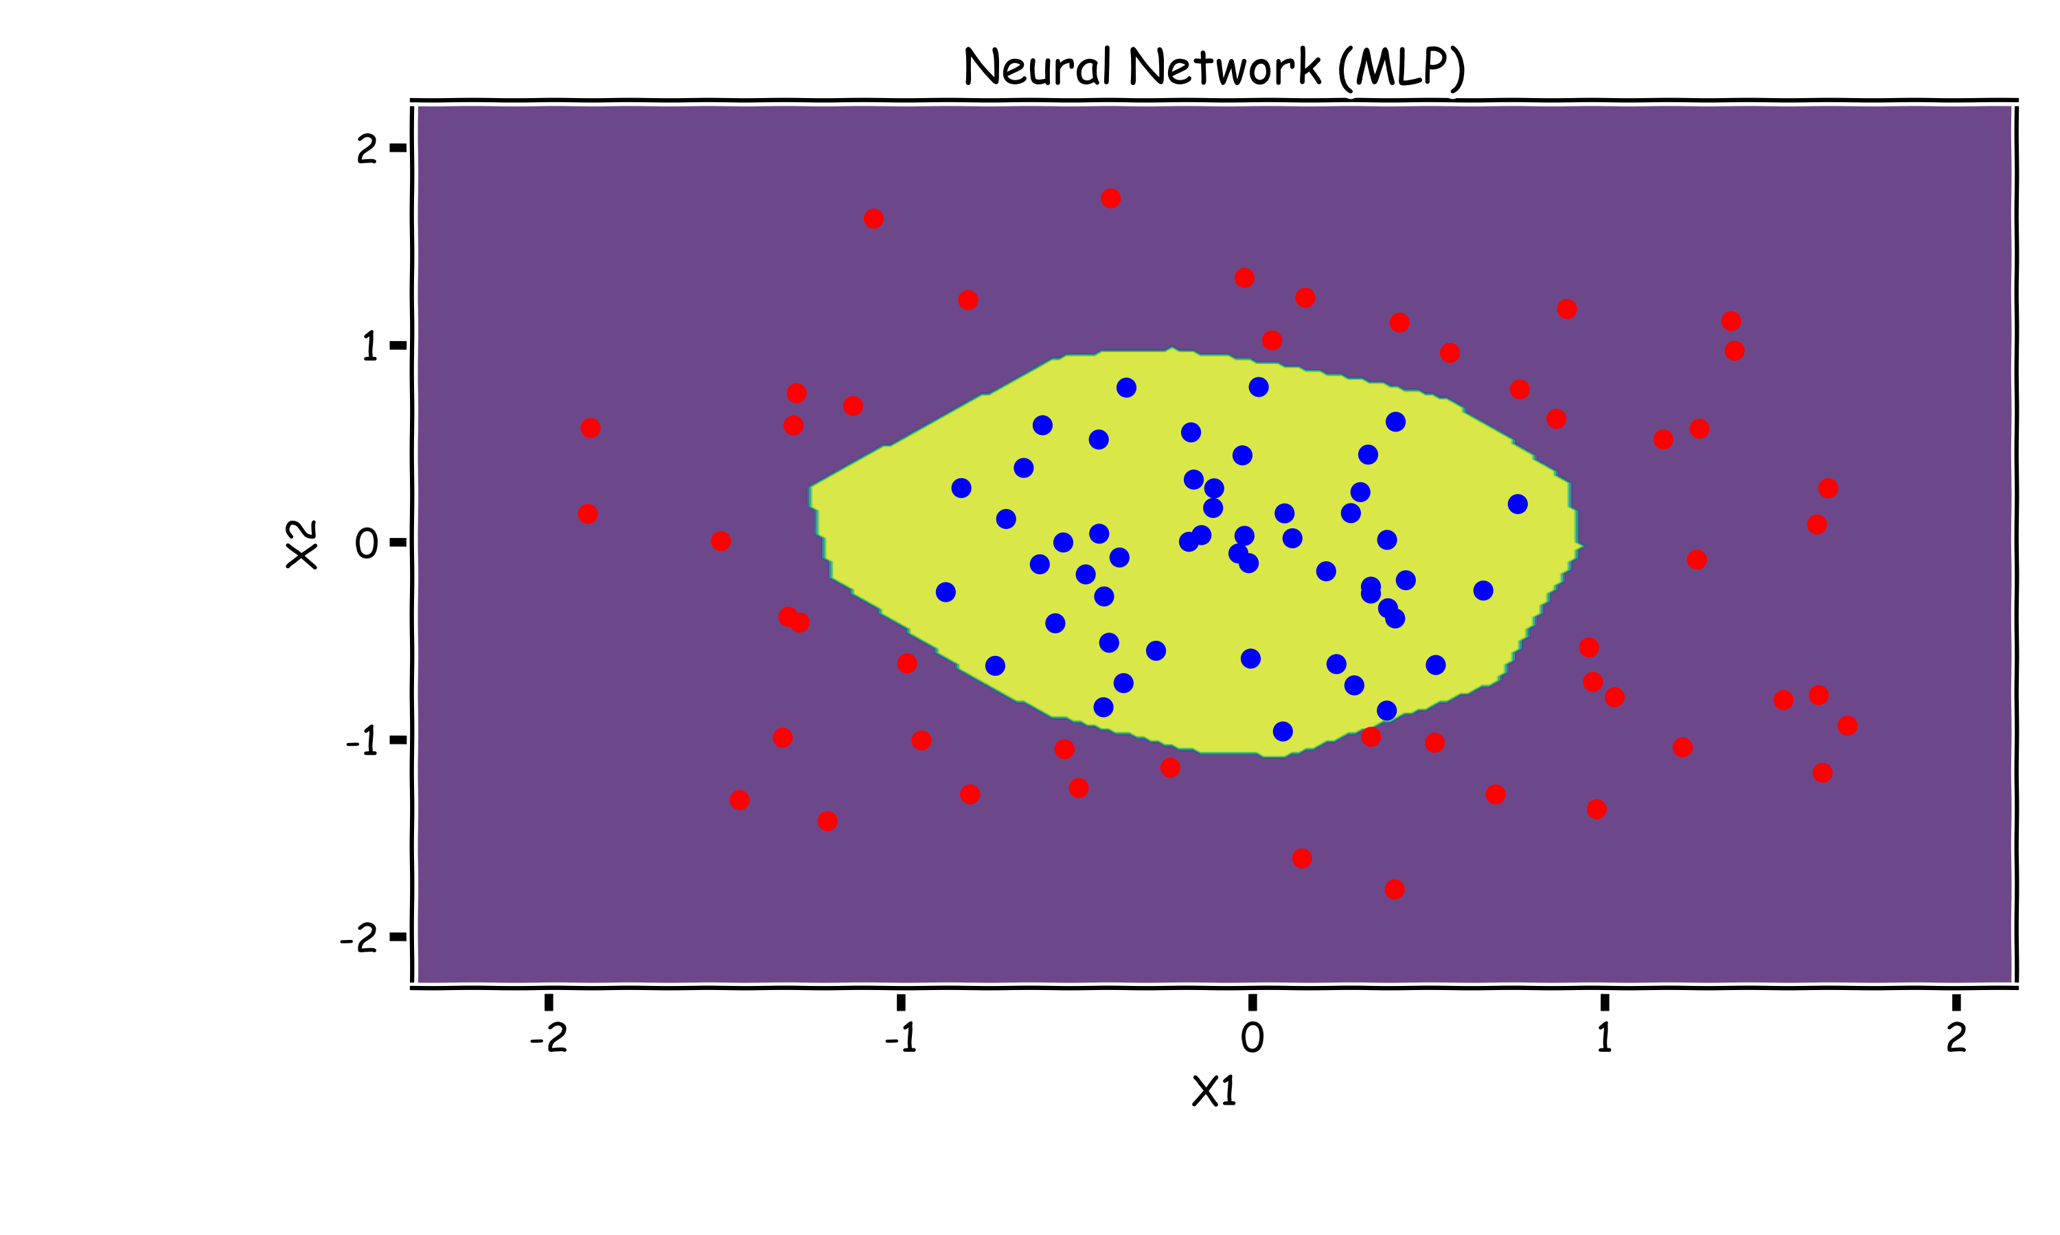
Neural Networks to The Rescue
A neural network is a powerful non-linear model that can easily model the non-linear decision boundary correctly.

Slide 31
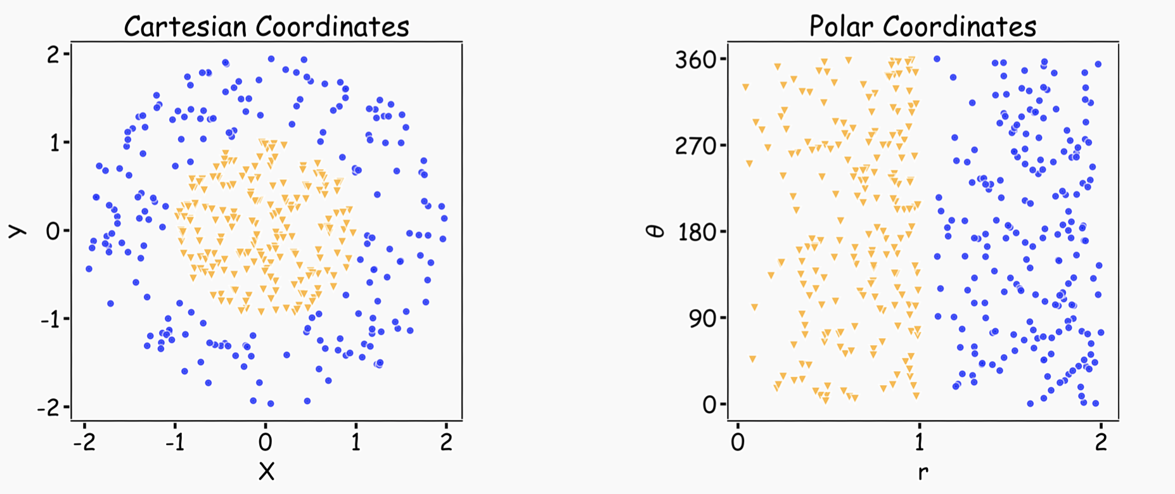
Representation Matters
Neural networks can learn useful representations for the problem. This is another reason why they can be so powerful!

Slide 32
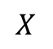
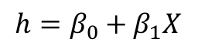
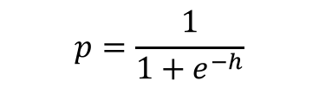
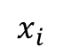
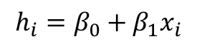
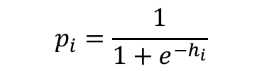
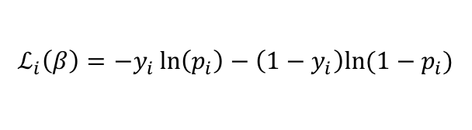
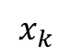
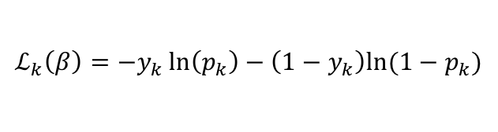
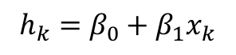
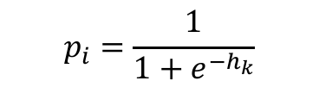

Logistic Regression Revisited
Affine
Activation
Loss Fun
$$p_{i}=\frac{1}{1+e^{−h_{i}}}$$
$$x_{i}$$
$$h_{i}=β_{0}+β_{1}x_{i}$$
$$ℒ_{i}\left(β\right)=−y_{i}\ln\left(p_{i}\right)−\left(1−y_{i}\right)ln⁡(1−p_{i})$$
Affine
Activation
Loss Fun
$$p_{i}=\frac{1}{1+e^{−h_{k}}}$$
$$x_{k}$$
$$h_{k}=β_{0}+β_{1}x_{k}$$
$$ℒ_{k}\left(β\right)=−y_{k}\ln\left(p_{k}\right)−\left(1−y_{k}\right)ln⁡(1−p_{k})$$
…
Affine
Activation
Loss Fun
$$ℒ(β)=\sum_{i}^{n}{ℒ_{i}\left(β\right)}$$
$$p=\frac{1}{1+e^{−h}}$$
$$X$$
$$h=β_{0}+β_{1}X$$

Slide 33
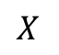
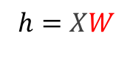
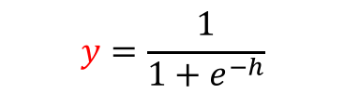

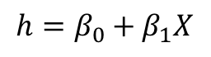
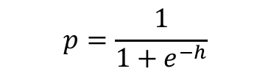

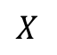
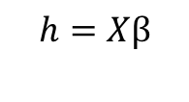
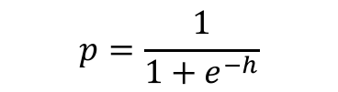

Build our first ANN
Affine
Activation
Loss Fun
$$ℒ(β)=\sum_{i}^{n}{ℒ_{i}\left(β\right)}$$
$$p=\frac{1}{1+e^{−h}}$$
$$X$$
$$h=β_{0}+β_{1}X$$
Affine
Activation
Loss Fun
$$ℒ(β)=\sum_{i}^{n}{ℒ_{i}\left(β\right)}$$
$$p=\frac{1}{1+e^{−h}}$$
$$X$$
$$h=Xβ$$
Affine
Activation
Loss Fun
$$ℒ(W)=\sum_{i}^{n}{ℒ_{i}\left(W\right)}$$
$$y=\frac{1}{1+e^{−h}}$$
$$X$$
$$h=XW$$

Slide 34
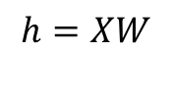
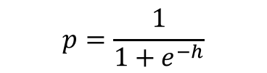
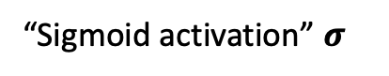


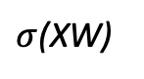

Build our first ANN
Affine
Activation
Loss Fun
$$ℒ(W)=\sum_{i}^{n}{ℒ_{i}\left(W\right)}$$
$$p=\frac{1}{1+e^{−h}}$$
$$X$$
$$h=XW$$
“Sigmoid activation” $σ$
$$X$$
$σ$(XW)
$$Y$$
Single Neuron Network
Very similar to Perceptron

Slide 35
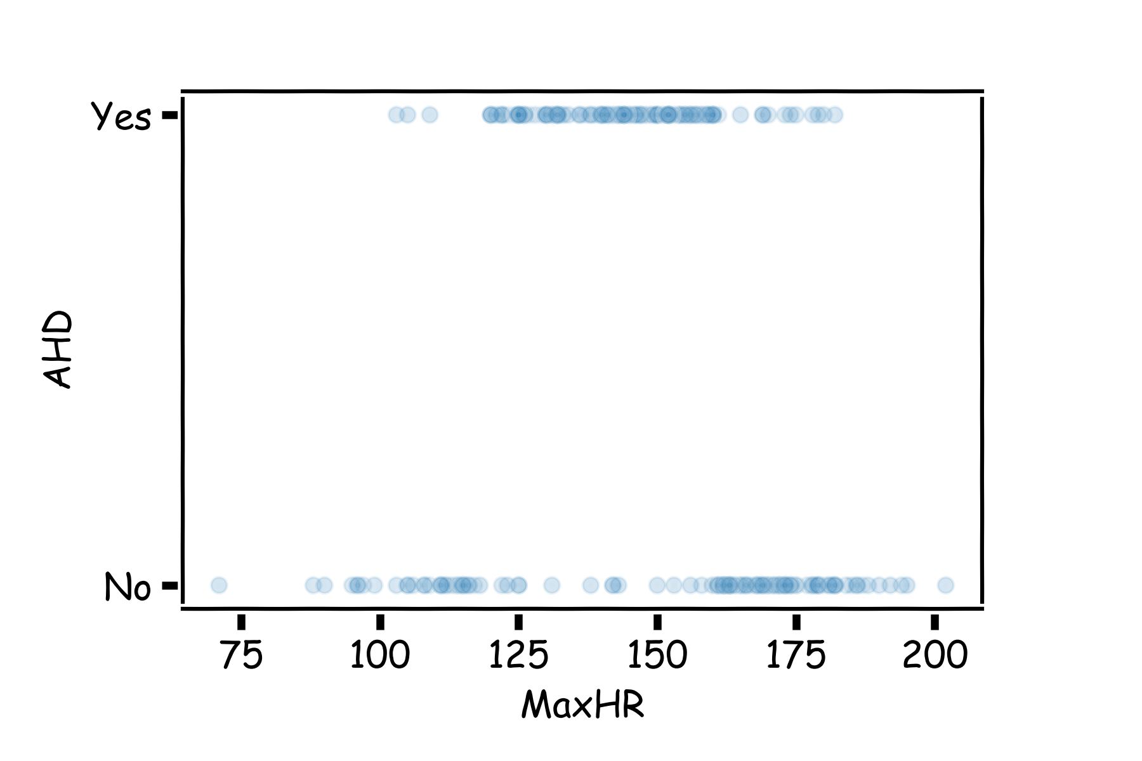
Example Using Heart Data
Slightly modified data to illustrate concepts.

Slide 36
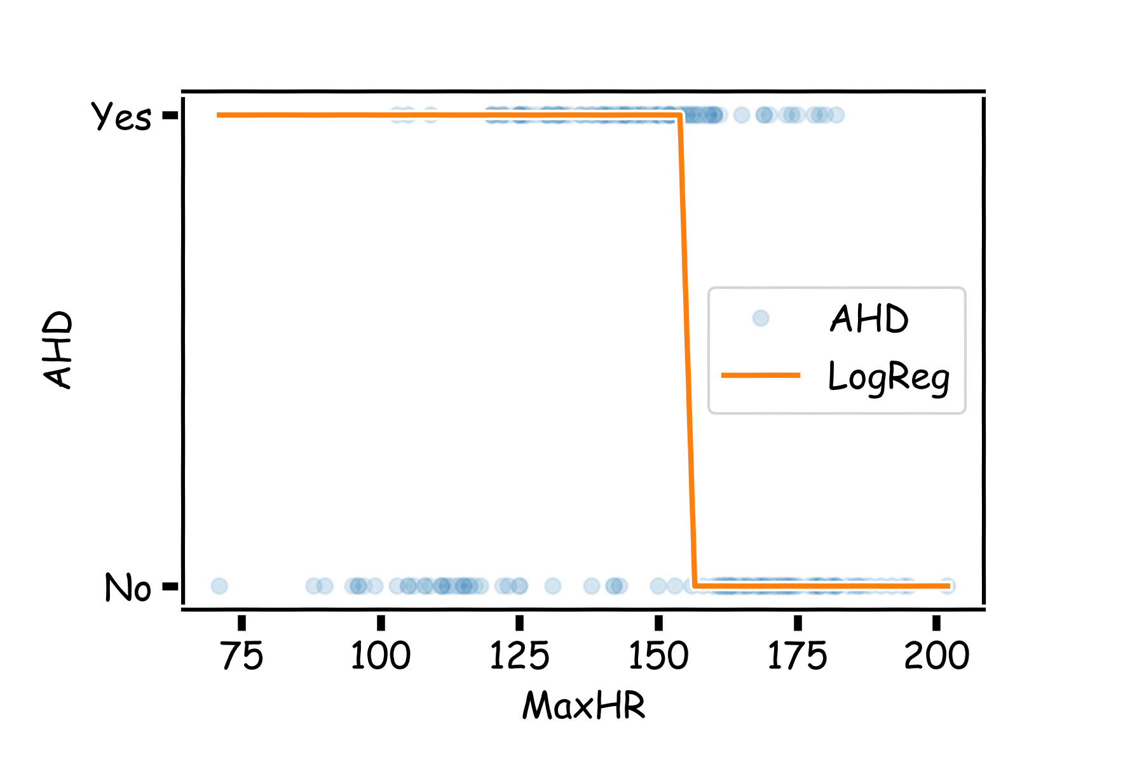


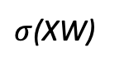
Example Using Heart Data
Choose W such as
$$X$$
$σ$(XW)
$$Y$$

Slide 37
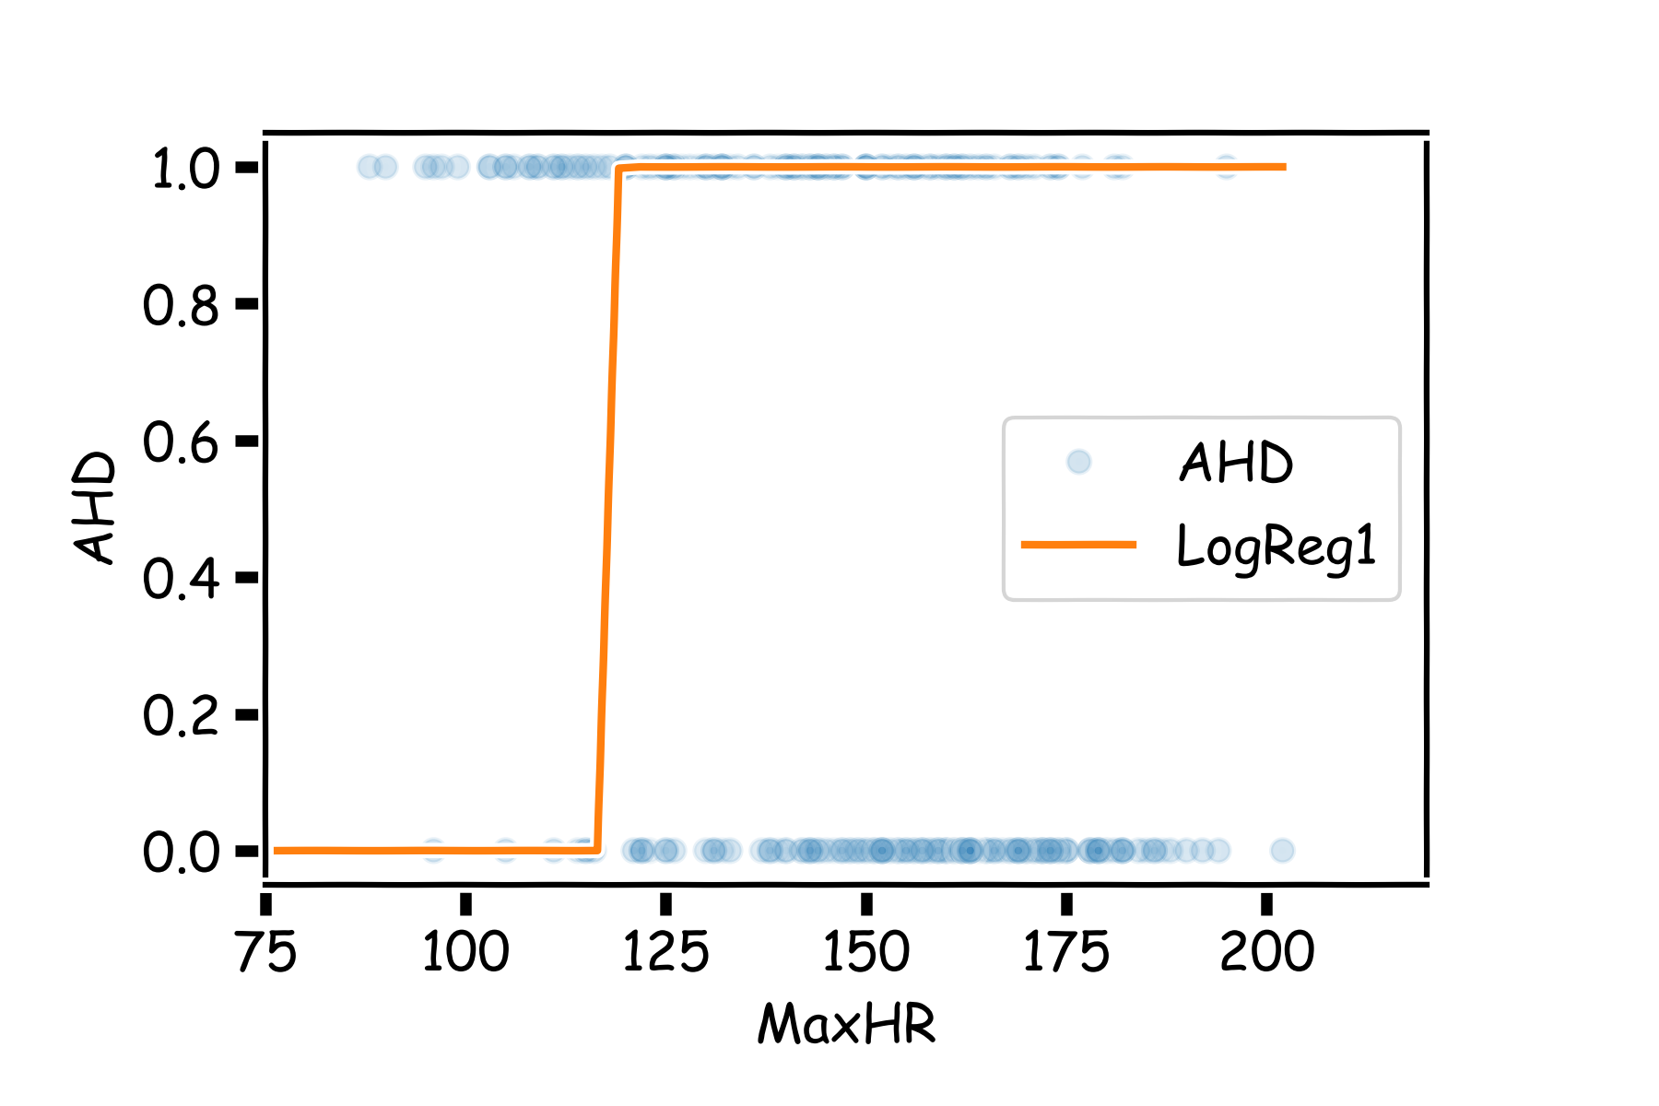
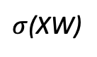
Example Using Heart Data
Choose W such as
$$X$$
$σ$(XW)
$$Y$$

Slide 38







Example
$$X$$
$σ$(XW₁)
$$Y$$
$$X$$
$σ$(XW₂)
$$Y′$$

Slide 39










Pavlos game #232
$σ$(XW₁)
$$Y$$
$$h_{1}$$
$$q= W_{31}h_{1}+{W_{32}h}_{2}+W_{30}$$
Affine (h1 + h2)
$$X$$
$$Y′$$
$$h_{2}$$
Not a probability!
$σ$(XW₂)

Slide 40




Pavlos game #232
$$q= W_{31}h_{1}+{W_{32}h}_{2}+W_{30}$$
$$p=\frac{1}{1+e^{−q}}$$
$σ$(XW₁)
$$Y$$
$$h_{1}$$
$$X$$
$σ$(hW₃)
$σ$(XW₂)
$$Y′$$
$$h_{2}$$
Passing through sigmoid yields probability
$$L=−y ln\left(p\right)−\left(1−y\right)ln(1−p)$$
Need to learn W1, W2 and W3.

Slide 41


Combining neurons allows us to model interesting functions

Slide 42

Different weights change the shape and position

Slide 43


Adding layers allows us to model increasingly complex functions

Slide 44


Neural networks can model any reasonable function

Slide 45
Summary
So far:
A single neuron can be a logistic regression unit. We will soon see other choices.
A neural network is a combination of logistic regression (or other types) units.
A neural network can approximate non-linear functions.
Next:
How many neurons?
What ”other choices”?
And beyond:
How do we estimate weights and biases?
Regularize Neural Networks.

Slide 46
Exercises
No quiz today
But super cool ED exercise

